Slide 1

WEEK 10
UML Diagram Level 4 Introduction to Internet Software Architecture

Slide 2
This week’s agenda
Understanding UML diagrams
Types of UML diagram

Slide 3


Slide 4
UML Diagram
UML stands for Unified Modeling Language
UML is different from the other common programming languages such as C++, Java, COBOL, etc
UML is a pictorial language used to make software blueprints
UML can be described as a general purpose visual modeling language to visualize, specify, construct, and document software system
Although UML is generally used to model software systems, it is not limited within this boundary. It is also used to model non-software systems as well. For example, the process flow in a manufacturing unit, etc

Slide 5
Uses of UML Diagram
• As a sketch: to communicate aspects of system
• Forward design: doing UML before coding
• Backward design: doing UML after coding as documentation
• Often done on whiteboard or paper
• Used to get rough selective ideas
• As a blueprint: a complete design to be implemented
• Sometimes done with CASE (Computer-Aided Software Engineering) tools
• As a programming language: with the right tools, code can be auto-generated and executed from UML
• Only good if this is faster than coding in a "real" language

Slide 6
Types of UML diagram
There are two main categories of UML Diagram
Structural Diagram
Structure diagrams show the things in the modeled system. In a more technical term, they show different objects in a system
Behavioral diagrams
Behavioral diagrams show what should happen in a system. They describe how the objects interact with each other to create a functioning system.

Slide 7
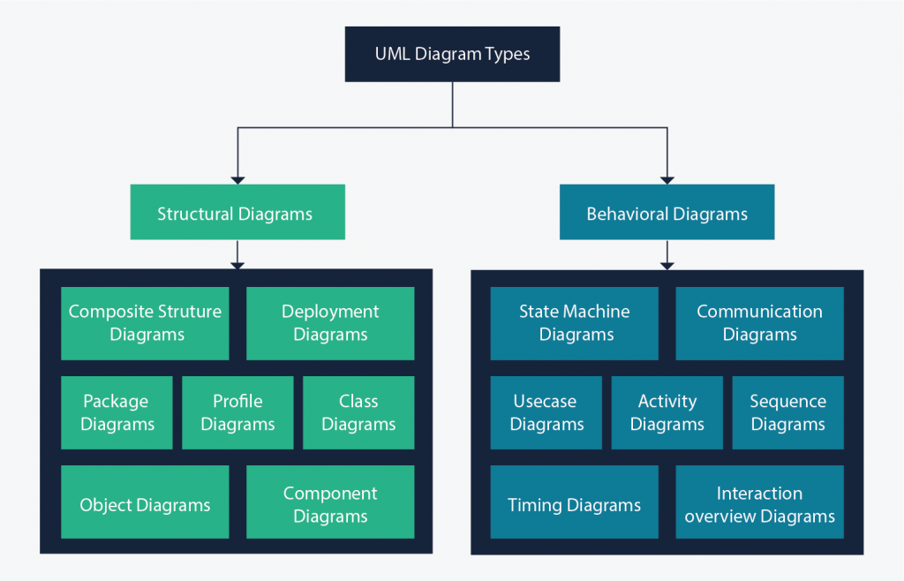

Slide 8
There are 14 UML diagrams types in total, but we are going to study only these
Class Diagram
Object Diagram
Deployment Diagram
Use Case Diagram
Activity Diagram
Sequence Diagram

Slide 9
UML - Getting Started
UML describes the real-time systems
It is very important to make a conceptual model and then proceed gradually
The conceptual model of UML can be mastered by learning the following three major elements −
UML building blocks
Rules to connect the building blocks
Common mechanisms of UML

Slide 10
UML - Building blocks
The building blocks of UML are
Things
Relationships
Diagrams

Slide 11
Things
Things are the most important building blocks of UML.
Things can be -
Structural
Behavioral
Grouping
Annotations

Slide 12


Structural Things
Structural things define the static part of the model. They represent the physical and conceptual elements. Following are the brief descriptions of the structural things.
Class − Class represents a set of objects having similar responsibilities.
Notaion:
Interface − Interface defines a set of operations, which specify the responsibility of a class.
Notation:

Slide 13




Structural Things - continued
Collaboration − Collaboration defines an interaction between elements.
Notation:
Use case − Use case represents a set of actions performed by a system for a specific goal.
Notation:
Component − Component describes the physical part of a system.
Notation:
Node − A node can be defined as a physical element that exists at run time.
Notation:

Slide 14


Behavioral Things
A behavioral thing consists of the dynamic parts of UML models. Following are the behavioral things −
Interaction − Interaction is defined as a behavior that consists of a group of messages exchanged among elements to accomplish a specific task.
Notation:
State machine − State machine is useful when the state of an object in its life cycle is important. It defines the sequence of states an object goes through in response to events. Events are external factors responsible for state change
Notation:

Slide 15

Grouping Things
Grouping things can be defined as a mechanism to group elements of a UML model together. There is only one grouping thing available −
Package − Package is the only one grouping thing available for gathering structural and behavioral things.
Notation:

Slide 16

Annotational Things
Annotational things can be defined as a mechanism to capture remarks, descriptions, and comments of UML model elements.
Note - It is the only one Annotational thing available. A note is used to render comments, constraints, etc. of an UML element.
Notation:

Slide 17
Relationship
Relationship
Relationship is another most important building block of UML. It shows how the elements are associated with each other and this association describes the functionality of an application.
There are four kinds of relationships available.
Dependency
Association
Generalization
Realization

Slide 18


Dependency is a relationship between two things in which change in one element also affects the other.
Notation:
Association is basically a set of links that connects the elements of a UML model. It also describes how many objects are taking part in that relationship.
Notation:

Slide 19
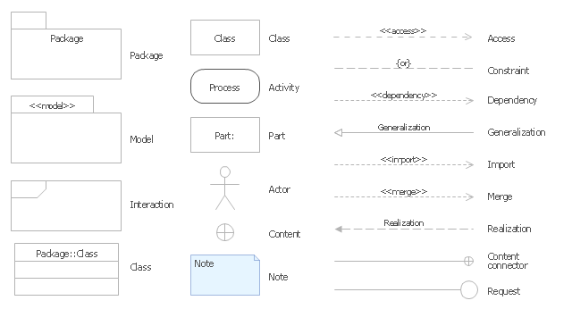
UML Notations

Slide 20
Class Diagram
Class diagrams are the main building block of any object-oriented solution
It shows the classes in a system, attributes, and operations of each class and the relationship between each class
In most modeling tools, a class has three parts. Name at the top, attributes in the middle and operations or methods at the bottom. In a large system with many related classes, classes are grouped together to create class diagrams. Different relationships between classes are shown by different types of arrows.

Slide 21
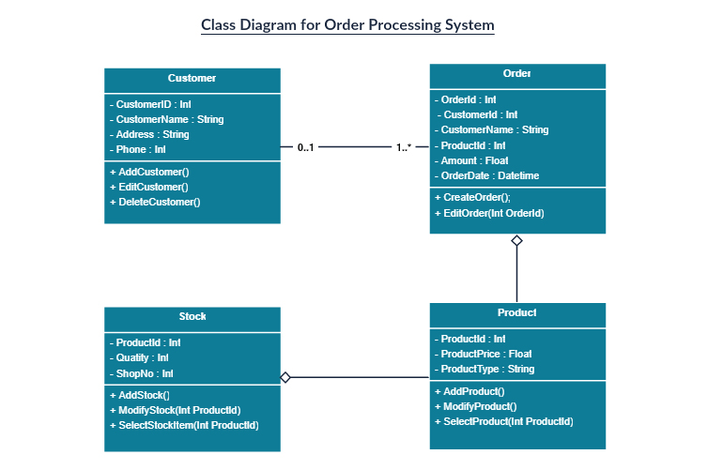

Slide 22
Object Diagram
Object Diagrams, sometimes referred to as Instance diagrams are very similar to class diagrams.
Like class diagrams, they also show the relationship between objects but they use real-world examples
They show how a system will look like at a given time
There is data available in the objects, they are used to explain complex relationships between objects

Slide 23
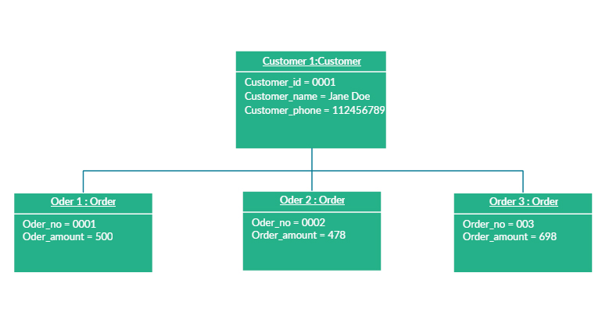

Slide 24
Deployment Diagram
A deployment diagram shows the hardware of your system and the software in that hardware
Deployment diagrams are useful when your software solution is deployed across multiple machines with each having a unique configuration

Slide 25
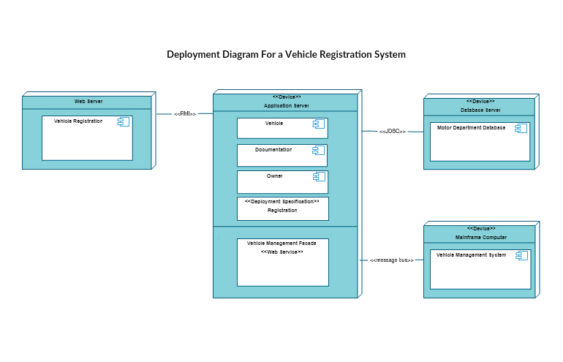

Slide 26
Use Case Diagram
Use case diagrams give a graphic overview of the actors involved in a system, different functions needed by those actors and how these different functions interact.
It’s a great starting point for any project discussion because you can easily identify the main actors involved and the main processes of the system

Slide 27
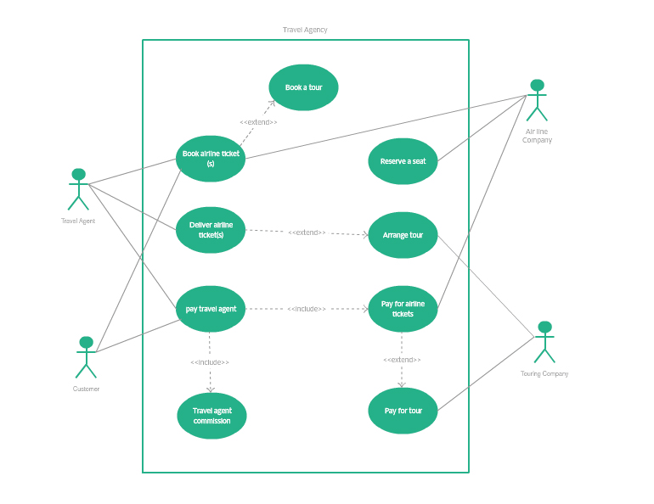

Slide 28
Activity Diagram
Activity diagrams represent workflows in a graphical way
They can be used to describe the business workflow or the operational workflow of any component in a system

Slide 29
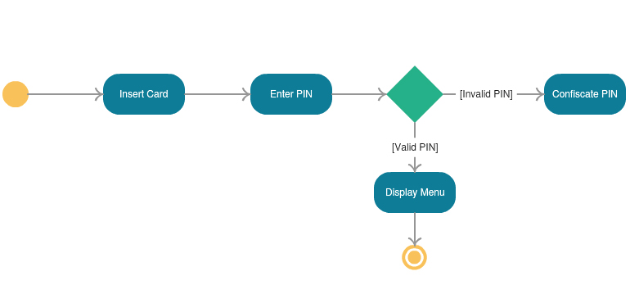

Slide 30
Sequence Diagram
Sequence diagrams in UML show how objects interact with each other and the order those interactions occur
It’s important to note that they show the interactions for a particular scenario
The processes are represented vertically and interactions are shown as arrows

Slide 31
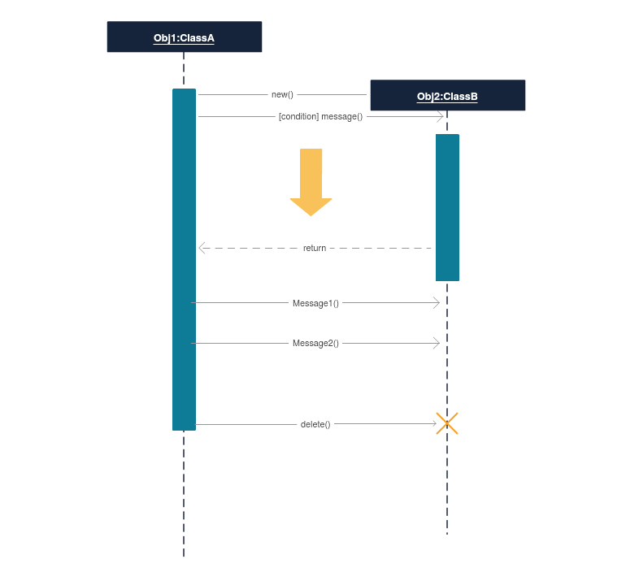

Slide 32

Any Questions

Slide 33
Before you come for Lab, Research!!
UML Diagrams - Javatpoint
UML Diagram - Everything You Need to Know About UML Diagrams (smartdraw.com)
UML Diagram Types | Learn About All 14 Types of UML Diagrams (creately.com)
UML - Standard Diagrams - Tutorialspoint

Slide 34


